Slide 1

USAID - Intelligent Forecasting Competition Results Summary
Aishwarya Sivasurya

Slide 2

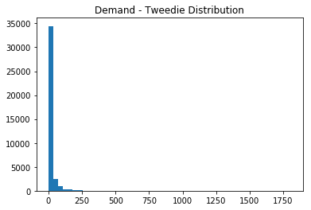



Exploratory Data Analysis
Demand follows a tweedie distribution.
Traditional and Machine Learning Algorithms – Global Models - on SKUs with less than 80% of records with zero demand
Naïve Forecasting Algorithm(Traditional) – Local Model - on SKUs with greater than 80% of records with zero demand

Slide 3
Feature Engineering
Product Causals
Site Causals
Trend
Seasonality
Categorical features
Product code
Site code
District
Average Monthly consumption lags (3 - 5)
Opening Stock Lags (3 - 5)
Simple Moving Average of Demand Lags (6 - 8)
Demand Lags (3 - 8)
Calendar Features
Year
Month
Quarter

Slide 4
Algorithms – Local and Global Models
Naïve Forecasting (Local Model)
Croston’s Method – Intermittent Forecasting (Local Model)
Catboost Regressor with Tweedie loss function (Global Model)
LightGBM Regressor with Tweedie loss function (Global Model)
Random Forest (Global Model)
XG Boost (Global Model)

Slide 5
Best Model Selection
Model with the lowest MASE on test data
Algorithms | Less than 40% | 40 - 60% | 60 - 80% | 40 - 80% | Greater than 80% | Total
Naïve Forecasting | 62 | 49 | 23 |  | 323 | 457
RandomForest Regressor | 68 | 2 | 2 | 86 |  | 158
Catboost Regressor | 58 | 21 | 15 | 35 |  | 129
Croston's Method | 75 |  |  | 49 |  | 124
LightGBM Regressor | 35 | 26 | 16 | 28 |  | 105
XGBoost Regressor | 37 |  |  | 36 |  | 73
Total | 335 | 98 | 56 | 234 | 323 | 1046
Records with zero demand | Average MASE
Less than 40% | 0.61
40 - 80% | 0.91
Greater than 80% | 0.58

